Slide 1




ARRAYS in JAVA
Group of liked type variables
Working is different in JAVA than C/C++.
Why?
Dynamic memory allocation
Arrays are objects in Java, can find there length using array_name.length, different from sizeof() in C/C++
Index starts from 0 always.
Can be used as a static field, local variable or method parameter.
Size of array must be specified as in integer value.
Creating arrays in Java
type var_name[]; OR
type[] var_name;
type var_name[][]; OR
type[][] varname;

Slide 2
Memory allocation to an array.
var_name = new type[size]; OR
type var_name = new type[size];
E.g. int arrayInt=new int[10];
Array Literal
int[] intArray ={ 1,2,3,4,5,6,7,8,9,10 };
Initialization
var_name[index]=value; OR
using for loop
for(int i=0; i<arr.length; i++){
System.out.println(arr[i]);
}
Passing arrays to methods:
Syntax: [access specifier] [modifier] [return type] func_name(type[] array_name)

Slide 3







Array of objects
Student[] s=new Student[5]; //student is user-defined class
To initialize the objects or create a object;
s[0] = new Student(1,”name”);
s[1] = new Student(2,”name”); and so on
To access the elements of an array:
for(int i=0; i<s.length; i++){
System.out.println(“Student id is:” + s[i].id + ”and name is:” + s[i].name)
}
To store the string data simply use the keyword;
String var_name;
(Will learn about Strings in more detail in later classes.)

Slide 4
NOTE:
Below are some UML diagrams using which write a Java program for each of them.
Use all the concepts taught up till now in the class for writing a program.
Make the program user interactive using Scanner class and If-else statements for checking the conditions wherever required.
The program must use more than one data for execution. For this make use of array.
These UML diagrams are for reference. You can add more classes or methods if you want, but the classes and methods given in the diagram should be the same.
You can also change the flow of execution of your program according to your need.

Slide 5
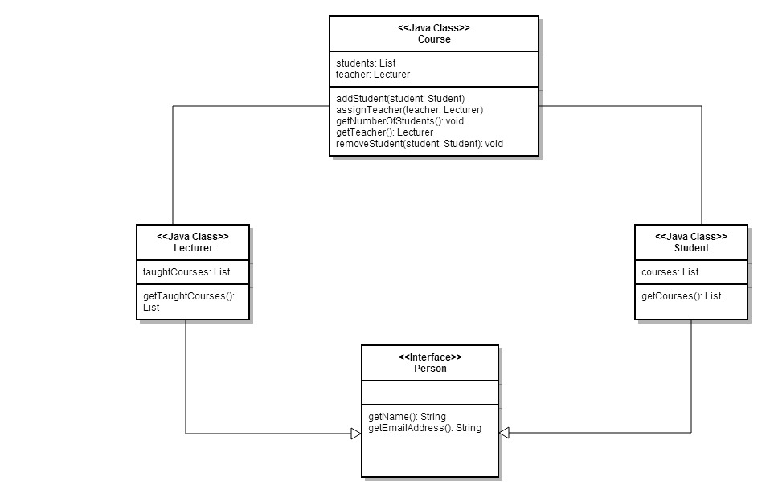
Practice questions

Slide 6
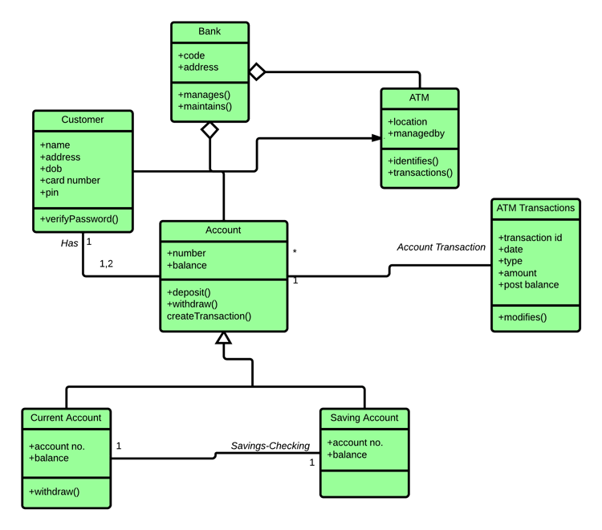

Slide 7
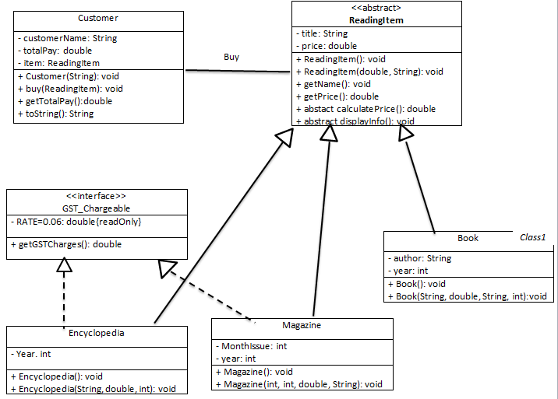

Slide 8
